Slide 1

MSE Project – Hypothesis Testing & Application of Machine Learning

Slide 2

Agenda
Research Question
Data Source
Introduction
T-Test
Z-Proportion Test
ANOVA
Chi-Square Test
Machine Learning

Slide 3


Research question
Is the Price of "Crossover“ body type same or significantly different from "Van" Body Types?
Is the proportions of 'sedan' & 'Crossover' Body Types are same for the registered vehicles ?
Is the distribution of mileage is similar across Engine Type - Diesel, Petrol and Gas ?
Are Brand and Body independent of each other?

Slide 4

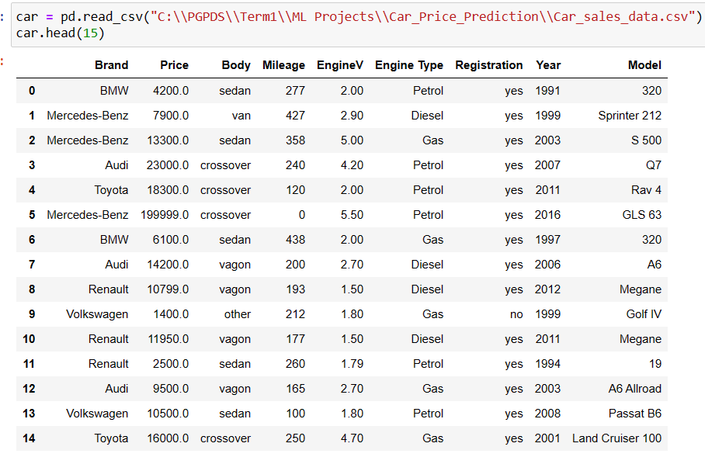
Data source
Secondary data source -https://www.cars.com

Slide 5

Methodology -1 Hypothesis Testing
We performed various statistical tests like T-Test, Z proportion Test, ANOVA and Chi Square Test to draw inferences from a sample statistic about a population parameter which helped to analyse relationships between various factors affecting price of cars.

Slide 6

Analysis and Results- T Test
Null Hypothesis : Mean Price is same for "Crossover" & "Van" Body Types for Used Cars
Alternative Hypothesis : Mean Price is significantly different for "Crossover" & "Van" Body Types for Used Cars..
A T-test done for the two body types “Crossover" & "Van“ which are the most bought by the family users suggest that the difference between the mean price of the two is significant as suggested by a P value lesser than a significant level of 0.05(95% confidence level)

Slide 7
Analysis and Results- Z Proportion Test
Null Hypothesis : The proportions of 'sedan' & 'Crossover' Body Types are same for registered vehicles
Alternate Hypothesis : The proportions of '' Sedan"& 'Crossover' Body Types are significantly different for registered vehicles
A significant P value lesser than the significance level of 0.05 (95% confidence level) suggest that we can reject the null hypothesis and that the proportion of '' Sedan"& “Crossover” body types significantly differ within registered vehicles.

Slide 8

Analysis and Results- ANOVA
Null Hypothesis : The distribution of mileage is similar across Engine Type - Diesel, Petrol and Gas
Alternate Hypothesis : The distribution of mileage is significantly different across Engine Type - Diesel, Petrol and Gas
A significant P value lesser than the significance level of 0.05 (95% confidence level) , suggest that we can reject the null hypothesis . So, The distribution of mileage is significantly different across Engine Types.

Slide 9
Analysis and Results- Chi Square Test
Null Hypothesis : Brand and Body are independent¶
Alternate Hypothesis : Brand and Body are dependent
A significant P value lesser than the significance level of 0.05 (95% confidence level) , suggest that we can reject the null hypothesis . which means A brand doesn’t necessarily focus on a single body type.

Slide 10
Methodology- 2 Machine Learning
Linear Regression Model (LR)- using this ML Model we can draw the best fit line between the independent and dependent variables , by minimizing the sum of square errors and it gave the R- square value 0.77 and RMSE is 0.429
Gradient Boosting Regressor (GBT) is another ensemble learning algorithm which makes use of multiple weak learners & grows sequential trees which try to correct the errors made by previous learner by targeting the residual in its own training. This model for our dataset gave us an R-Squared value of 0.81 & RMSE of 0.390
The order of significance of Model in explaining the variance of our Target is GBT > RF > LR
The order of significance in terms of Root Mean Squared Error i.e, Least error to most GBT > RF > LR
Random Forest Regressor (RF) is an ensemble learning method which makes an aggregation of results from multiple base learners (Decision Tress in this case),usually an average for continuous values & the hard voting for Classification cases. For this dataset, the model gave us an R-Squared value of 0.80 & RMSE of 0.394

Slide 11
Feature Importance
Mileage [1]
Registration [2]
Engine Volume [3]
Body [4]
Brand [5]
Engine Type [6]

Slide 12
Conclusion
Gradient boosting gave us the highest R-Square & explains about 81.25% of the variance in the Price of Used Cars
Mileage is the most important feature followed by Registration , Engine Vol, Brand, Body & Engine Type
Hypothesis Testing helped us determine the comparison between various Body types for Mileage & Proportion , dependence between body & brand along with Distribution of Mileage across engine types

Slide 13

Thank You

